Slide 1

Towards Vivid and Diverse Image Colorization with Generative Color Prior
anze Wu, Xintao Wang, Yu Li,
Honglun Zhang, Xun Zhao, Ying Shan

Slide 2
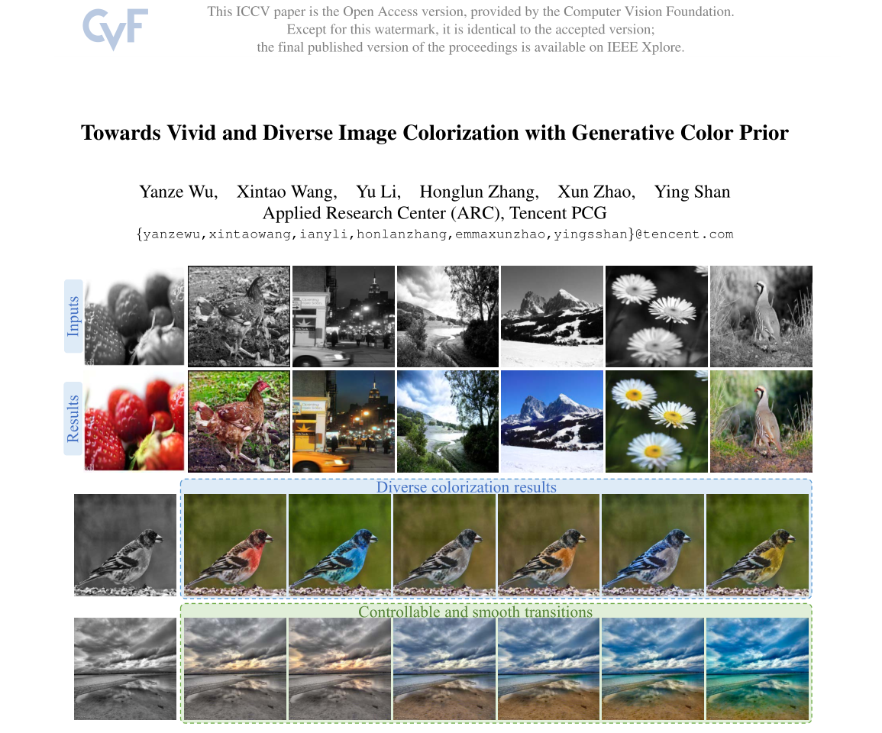

Slide 3
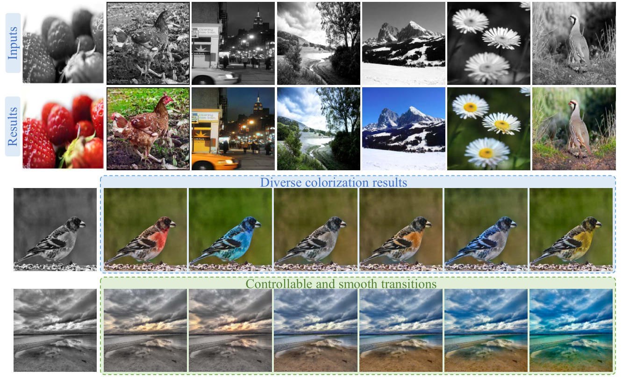
Introduction
Colorization: the task of restoring colors from black-and-white photos

Slide 4
Introduction
Reference-based
Additional example color images as guidance
A large-scale color image database or online search engine is inevitably required in the system
CNN based
Automatic
Learn to discover the semantics, and then directly predict the colorization results
Unsatisfactory artifacts and incoherent colors

Slide 5
Introduction
Reference-based + CNN-based method
This is a unified framework to leverage rich and diverse generative color prior for automatic colorization.
Retrieve features via a GAN encoder and then incorporate these features into the colorization process.
Achieving diverse colorization from different samples in the GAN distribution or by modifying GAN latent codes.

Slide 6
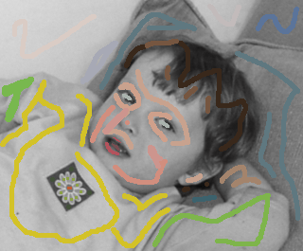
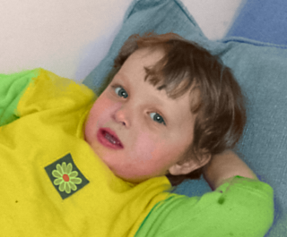
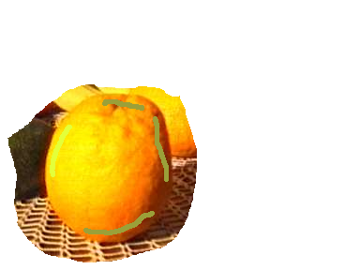
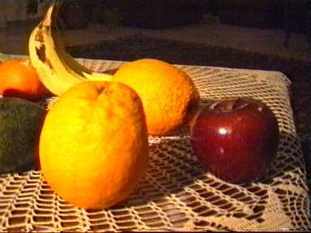
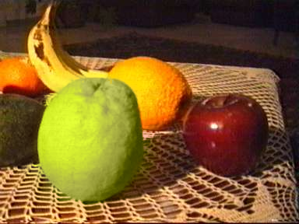
Related Work
Require users to draw color strokes on the gray image to guide the colorization
Assign two pixels with the same color if they are adjacent and similar under similarity measures.
User assisted colorization
https://www.cs.huji.ac.il/w~yweiss/Colorization/

Slide 7
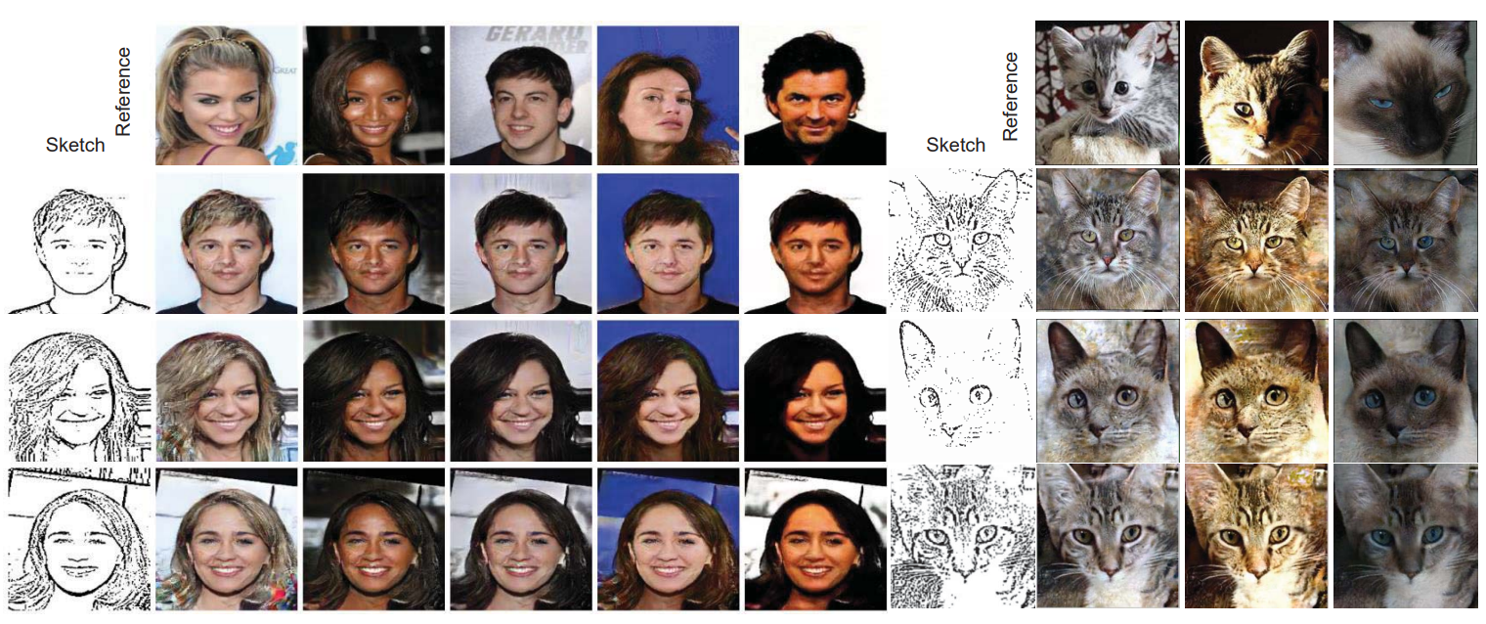
Related Work
Transfer the color statistics from the reference to the gray image using correspondences between the two based on
low-level similarity measures
semantic features
super-pixels
The procedure of finding references is time-consuming and challenging for automatic retrieval system
Reference-based methods

Slide 8
Related Work
Pre-trained networks for classification are used for better semantic representation.[1]
Two branch dual-task structures are also proposed [2] in that jointly learn the pixel embedding and local (semantic maps) or global (class labels) information
The recent work [3] investigates the instance-level features to model the appearance variations of objects
Automatic colorization
Gustav Larsson, Michael Maire, and Gregory Shakhnarovich. Learning representations for automatic colorization. In ECCV, 2016
Satoshi Iizuka, Edgar Simo-Serra, and Hiroshi Ishikawa. Let there be color! ACM TOG, 35(4):1–11, 2016.
Jheng-Wei Su, Hung-Kuo Chu, and Jia-Bin Huang. Instance-aware image colorization. In CVPR, 2020.

Slide 9
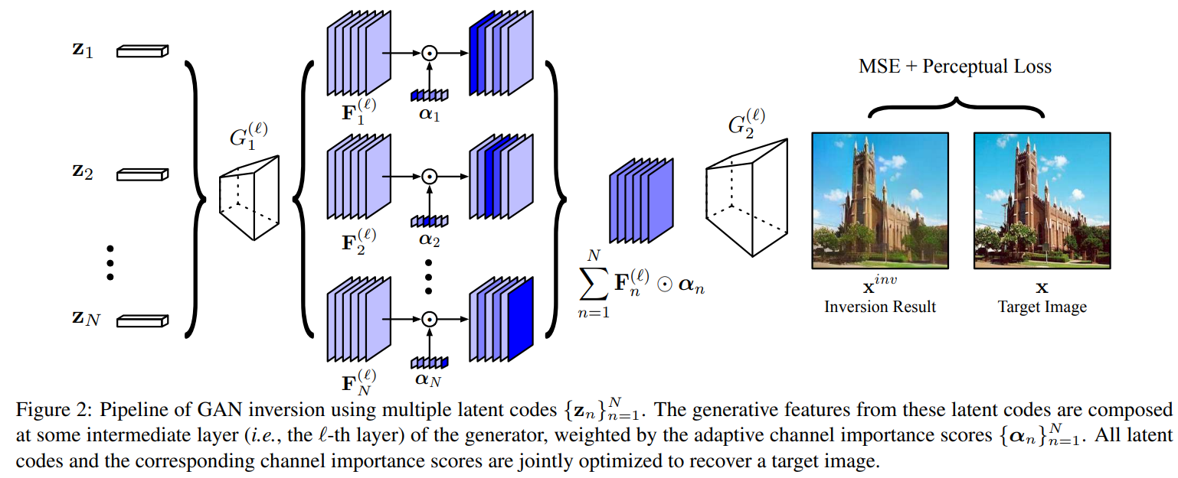
Related Work Generative priors
Generative priors of pretrained GANs is exploited by GAN inversion which aims to find the closest latent codes given an input image
In colorization, they first ‘invert’ the grayscale image back to a latent code of the pretrained GAN, and then conduct iterative optimization to reconstruct images
However, these results struggle to faithfully retain the local details, as the low-dimension latent codes without spatial information are insufficient to guide the colorization.
Jinjin Gu, Yujun Shen, and Bolei Zhou. Image processing using multi-code gan prior. In CVPR, 2020

Slide 10
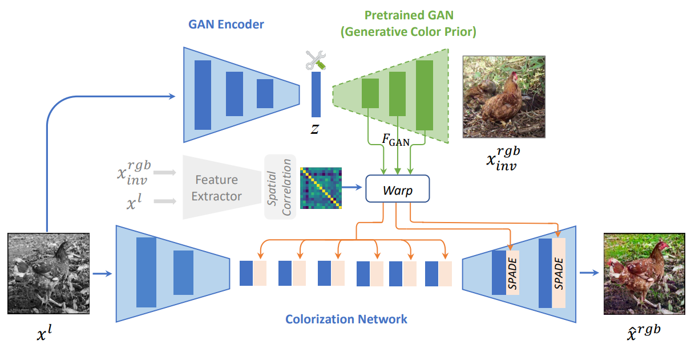
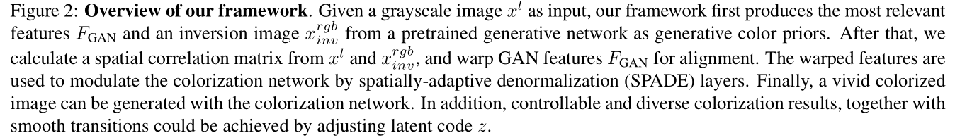
Method

Slide 11
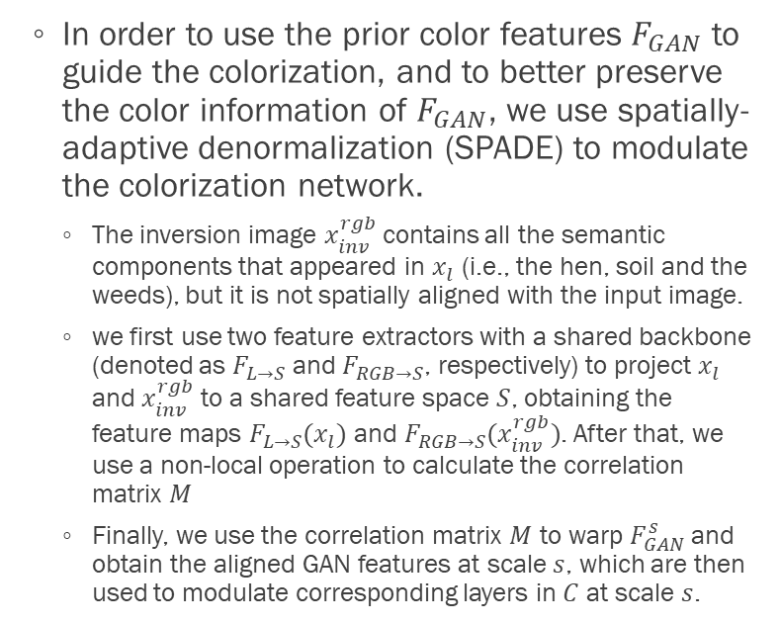
Colorization Network
In order to use the prior color features $F_{GAN}$ to guide the colorization, and to better preserve the color information of $F_{GAN}$, we use spatially-adaptive denormalization (SPADE) to modulate the colorization network.
The inversion image $x_{inv}^{rgb}$contains all the semantic components that appeared in $x_{l}$ (i.e., the hen, soil and the weeds), but it is not spatially aligned with the input image.
we first use two feature extractors with a shared backbone (denoted as $F_{L→S}$ and $F_{RGB→S}$, respectively) to project $x_{l}$ and $x_{inv}^{rgb}$ to a shared feature space $S$, obtaining the feature maps $F_{L→S}(x_{l})$ and $F_{RGB→S}(x_{inv}^{rgb})$. After that, we use a non-local operation to calculate the correlation matrix $M$
Finally, we use the correlation matrix $M$ to warp $F_{GAN}^{s}$and obtain the aligned GAN features at scale $s$, which are then used to modulate corresponding layers in $C$ at scale $s$.

Slide 12
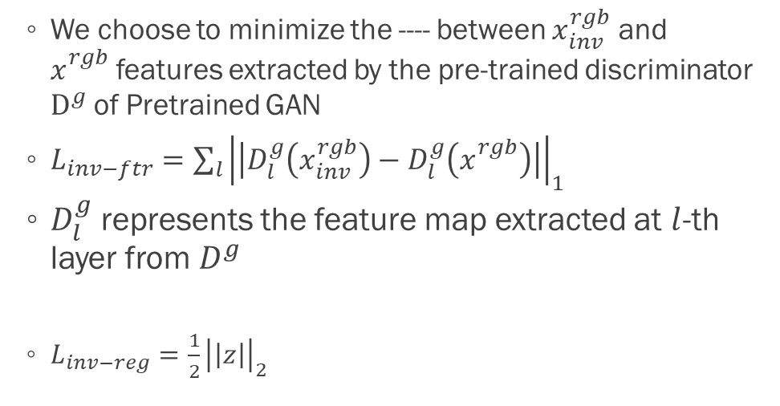
Objectives
We choose to minimize the ---- between $x_{inv}^{rgb}$ and $x_{}^{rgb}$features extracted by the pre-trained discriminator $D^{g}$of Pretrained GAN
$L_{inv−ftr}={\sum_{l}{\left|\left|D_{l}^{g}\left(x_{inv}^{rgb}\right)−D_{l}^{g}\left(x_{}^{rgb}\right)\right|\right|}}_{1}$
$D_{l}^{g}$represents the feature map extracted at $l$-th layer from $D^{g}$
$L_{inv−reg}=\frac{1}{2}{\left|\left|z\right|\right|}_{2}$
GAN inversion losses

Slide 13
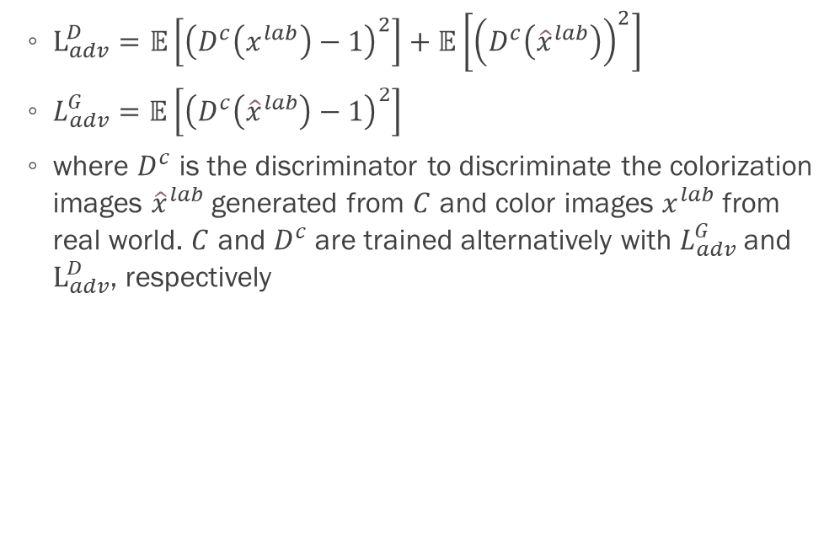
Objectives
$L_{adv}^{D}=𝔼\left[{\left(D^{c}\left(x^{lab}\right)−1\right)}^{2}\right]+𝔼\left[{\left(D^{c}\left({\hat{x}}^{lab}\right)\right)}^{2}\right]$
$L_{adv}^{G}=𝔼\left[{\left(D^{c}\left({\hat{x}}^{lab}\right)−1\right)}^{2}\right]$
where $D^{c}$ is the discriminator to discriminate the colorization images ${\hat{x}}^{lab}$generated from $C$ and color images $x^{lab}$ from real world. $C$ and $D^{c}$ are trained alternatively with $L_{adv}^{G}$and $L_{adv}^{D}$, respectively
Adversarial loss

Slide 14
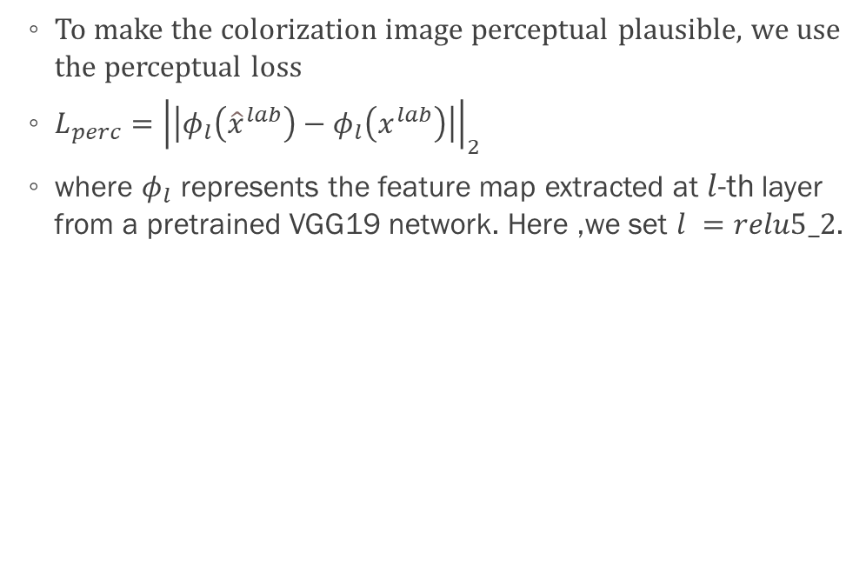
Objectives
To make the colorization image perceptual plausible, we use the perceptual loss
$L_{perc}={\left|\left|φ_{l}\left({\hat{x}}^{lab}\right)−φ_{l}\left(x^{lab}\right)\right|\right|}_{2}$
where $φ_{l}$ represents the feature map extracted at $l$-th layer from a pretrained VGG19 network. Here ,we set $l =relu5_2$.
Perceptual loss

Slide 15
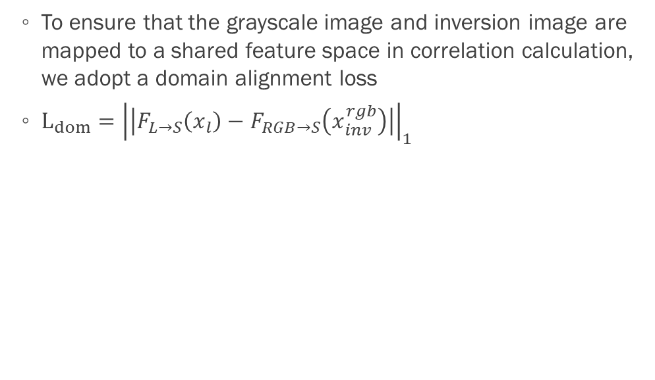
Objectives
To ensure that the grayscale image and inversion image are mapped to a shared feature space in correlation calculation, we adopt a domain alignment loss
$L_{dom}={\left|\left|F_{L→S}\left(x_{l}\right)−F_{RGB→S}\left(x_{inv}^{rgb}\right)\right|\right|}_{1}$
Domain alignment loss

Slide 16
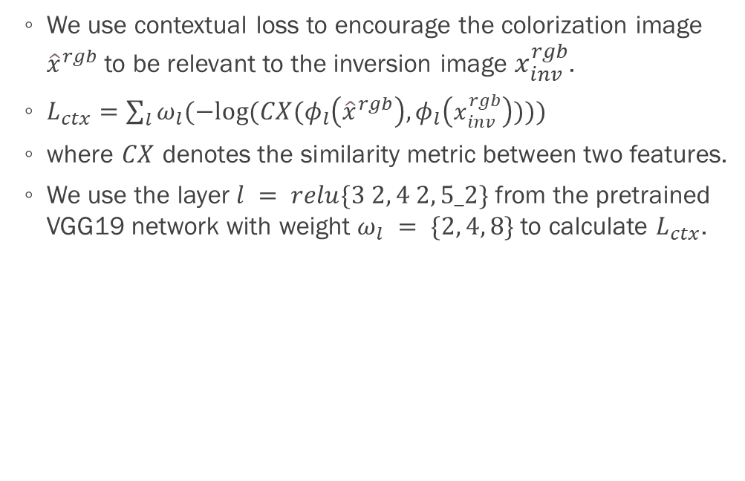
Objectives
We use contextual loss to encourage the colorization image ${\hat{x}}^{rgb}$ to be relevant to the inversion image $x_{inv}^{rgb}$.
$L_{ctx}=\sum_{l}{ω_{l}(−log⁡(CX(φ_{l}\left({\hat{x}}^{rgb}\right),φ_{l}\left(x_{inv}^{rgb}\right))))}$
where $CX$ denotes the similarity metric between two features.
We use the layer $l = relu\{3 2, 4 2, 5_2\}$from the pretrained VGG19 network with weight $ω_{l} = \{2, 4, 8\}$to calculate $L_{ctx}$.
Contextual Loss

Slide 17
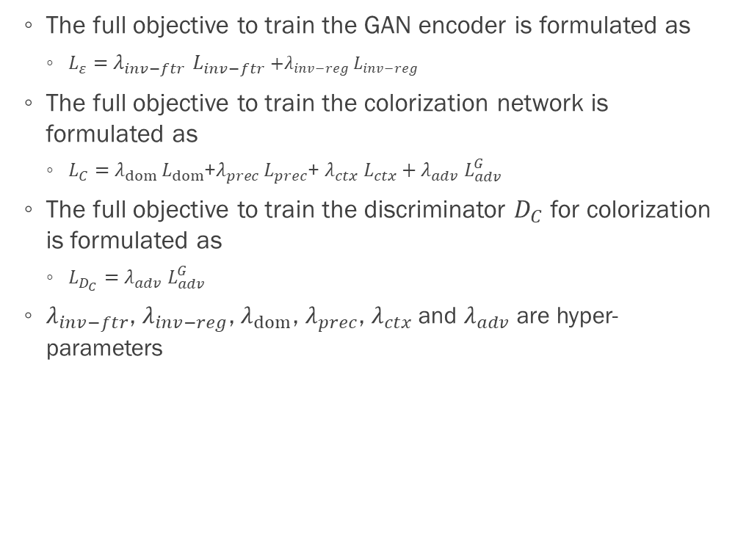
Objectives
The full objective to train the GAN encoder is formulated as
$L_{ε}=$ $λ_{inv−ftr}$ $L_{inv−ftr}$ ${+λ}_{inv−reg}$ $L_{inv−reg}$
The full objective to train the colorization network is formulated as
$L_{C}=$ $λ_{dom}$ $L_{dom}$+$λ_{prec}$ $L_{prec}$+ $λ_{ctx}$ $L_{ctx}+λ_{adv} L_{adv}^{G}$
The full objective to train the discriminator $D_{C}$ for colorization is formulated as
${L_{D_{C}}=λ}_{adv} L_{adv}^{G}$
$λ_{inv−ftr}$, $λ_{inv−reg}$, $λ_{dom}$, $λ_{prec}$, $λ_{ctx}$ and $λ_{adv}$are hyper-parameters
Full objective

Slide 18
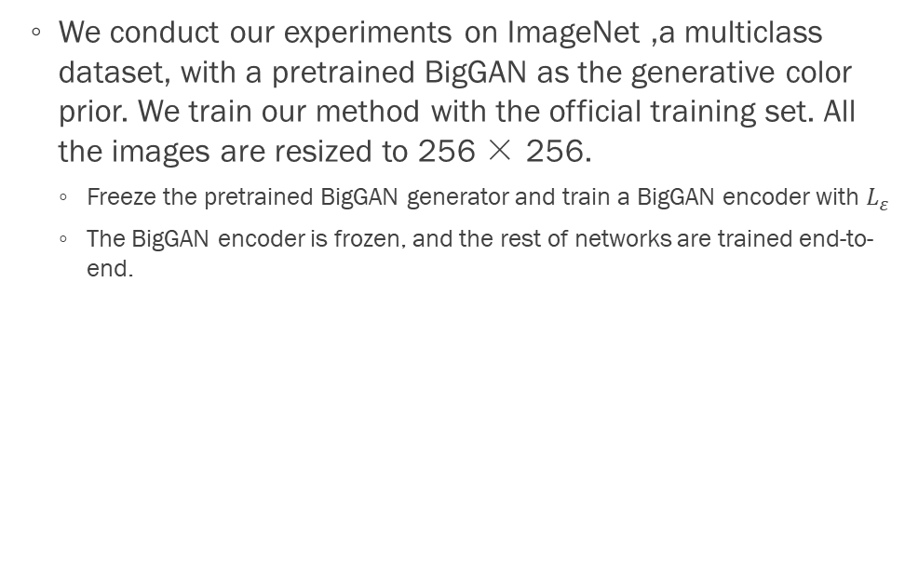
Experiments
We conduct our experiments on ImageNet ,a multiclass dataset, with a pretrained BigGAN as the generative color prior. We train our method with the official training set. All the images are resized to 256 × 256.
Freeze the pretrained BigGAN generator and train a BigGAN encoder with $L_{ε}$
The BigGAN encoder is frozen, and the rest of networks are trained end-to-end.

Slide 19
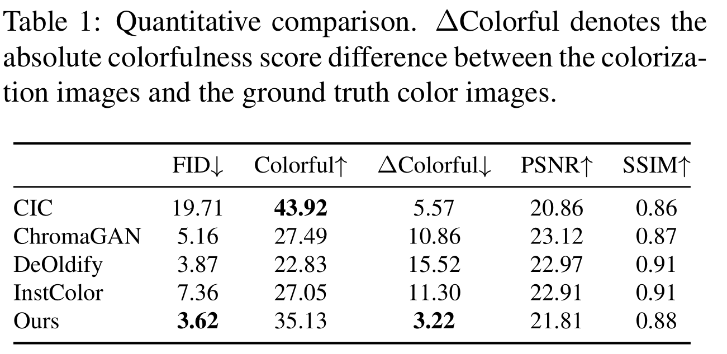
Experiments
Frechet Inception Score (FID) : measures the distribution similarity between the colorization results and the ground truth color images.
Colorfulness Score: reflects the vividness of generated images.
PSNR: peak signal-to-noise ratio is an expression for the ratio between the maximum possible value of a signal and the power of distorting noise that affects the quality of its representation.
SSIM: The structural similarity index measure is a method for predicting the perceived quality of digital pictures.
Comparisons with Previous Methods

Slide 20
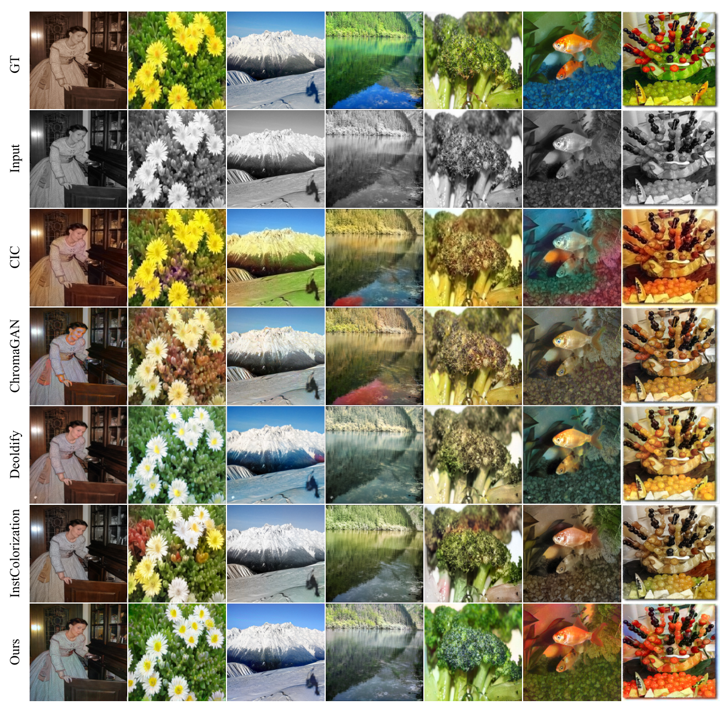

Slide 21
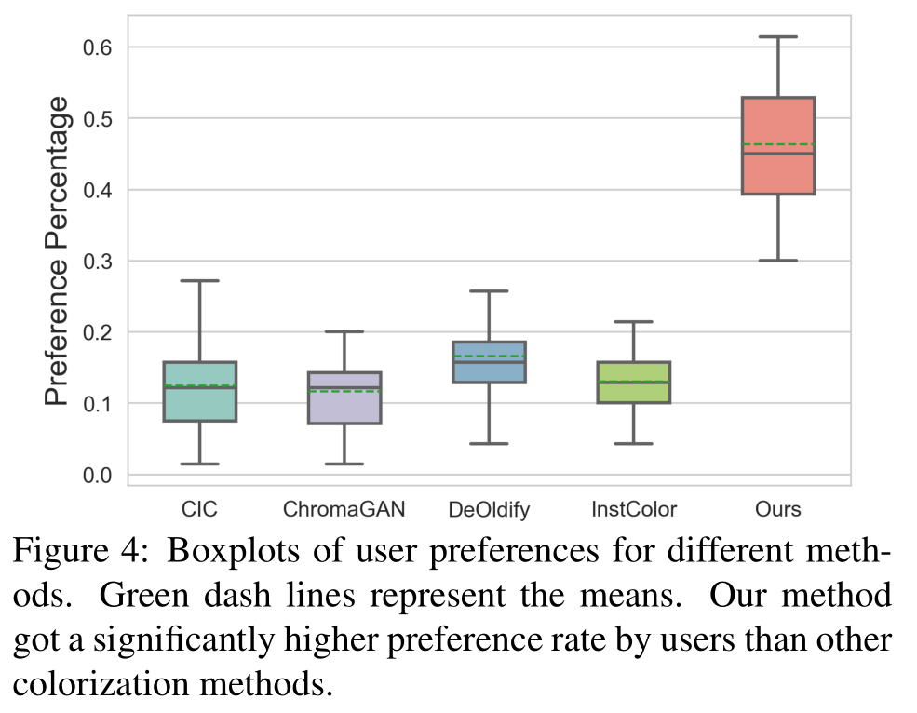
Experiments
In order to better evaluate the subjective quality (i.e., vividness and diverseness of colors), we conduct a user study to compare our method with the other state-of-art automatic colorization methods
User study

Slide 22
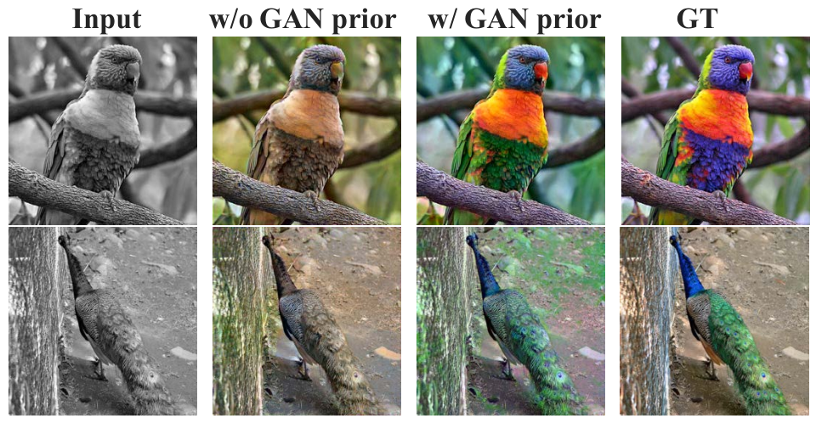
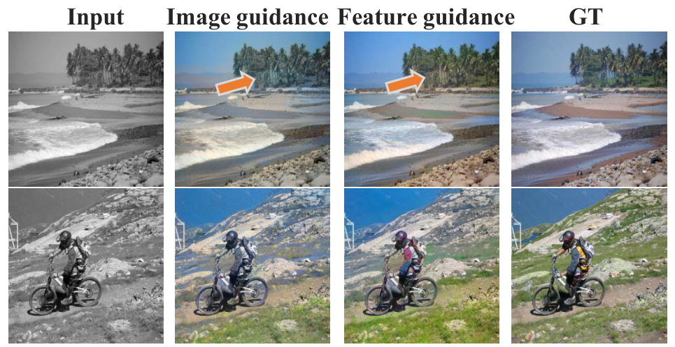
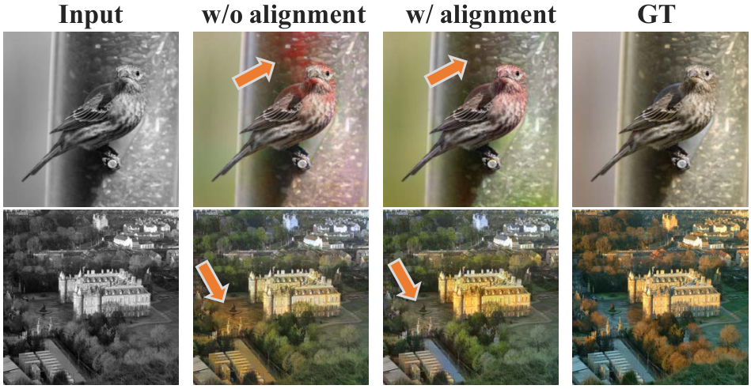
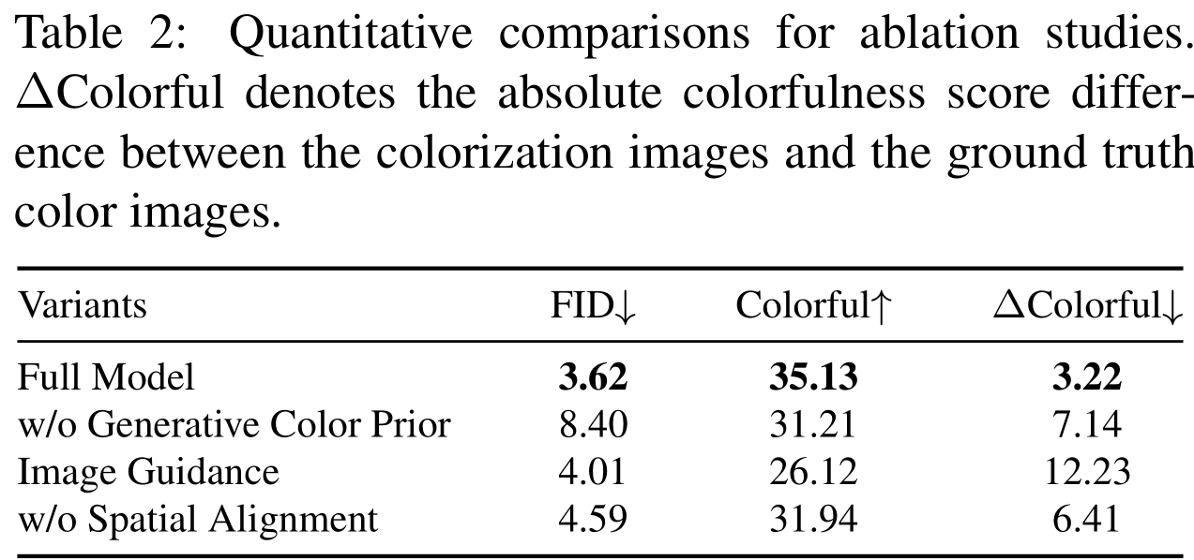
Experiments
Generative color prior
Feature guidance vs. image guidance.
Spatial alignment

Slide 23
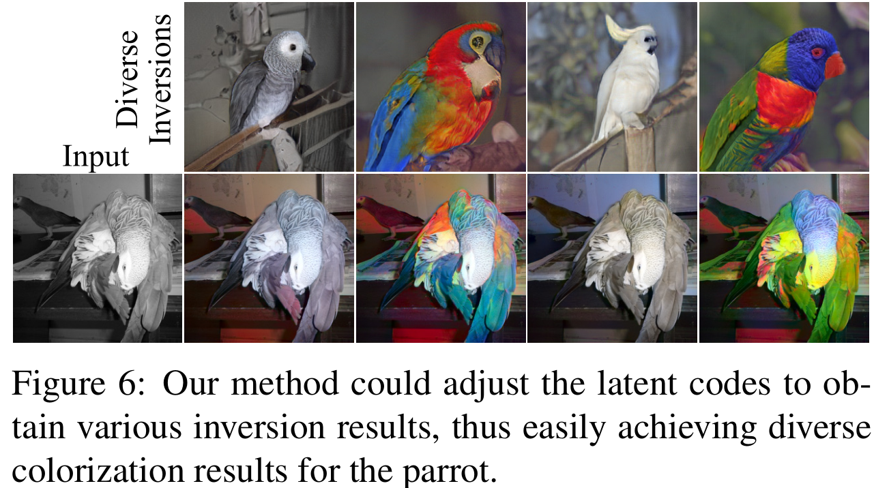
Experiments
Controllable Diverse Colorization

Slide 24
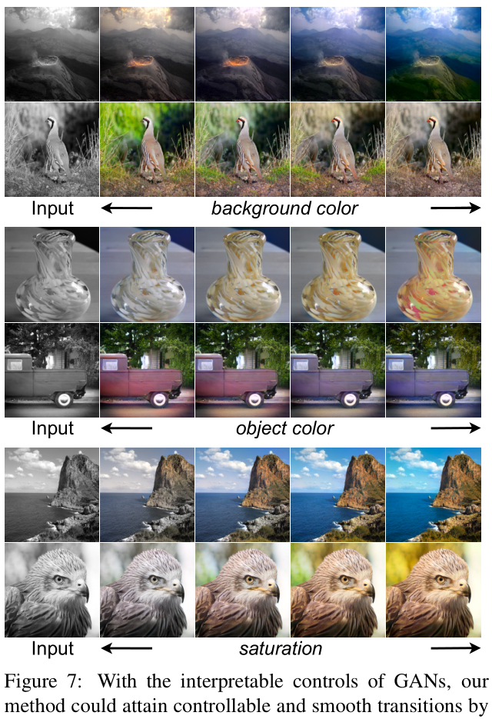
Experiments
We employ an unsupervised method to find color-relevant directions, such as lighting, saturation, etc.
Controllable Diverse Colorization

Slide 25
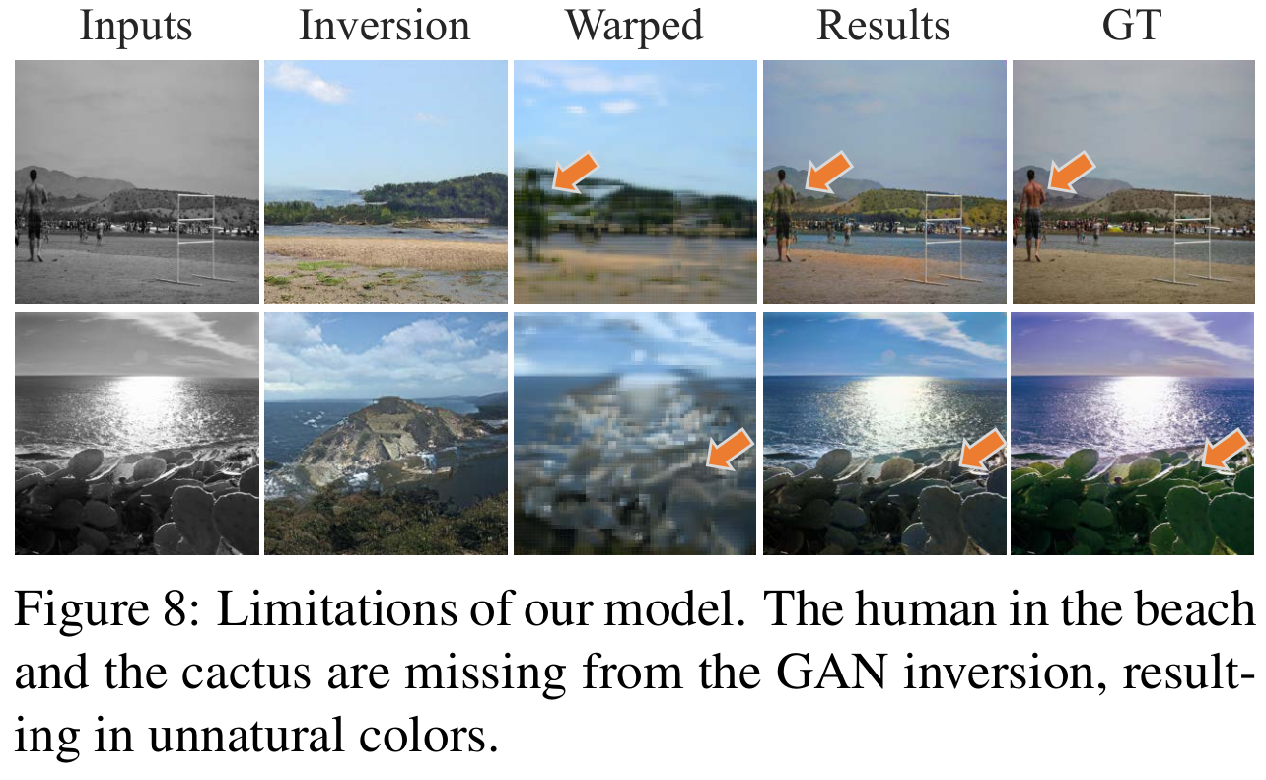
Limitations
When the input image is not in the GAN distribution or GAN inversion fails, our method degrades to common automatic colorization methods and may result in unnatural and incoherent colors.

